Slide 1
Estimation Target Is Relevant
Brian Caffo, Jeff Leek, Roger Peng
@bcaffo
www.bcaffo.com

Slide 2
Wisdom from Stills/Preston/Isley
If you can't be with the one you love, love the one you're with

Slide 3
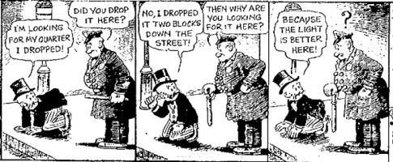
Even less inspiring
http://quoteinvestigator.com/wp-content/uploads/2013/04/muttjeff01.jpg

Slide 4
Common problem
It’s very common to not be able to directly measure what is most germane to your investigation
BMI as a measure of body fat percentage
GDP as a measure of economic well being
Food frequency questionnaires for calorie consumption
Likely voters versus actual voters
Web hits versus actual web traffic
BOLD signal versus brain activation

Slide 5
Good surrogates
Good surrogate outcomes:
Unbiased
Known variance around the desired outcome

Slide 6

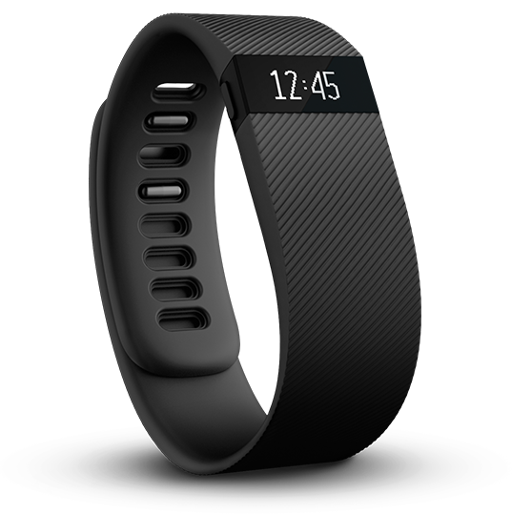
Second best setting
Build models of the truth on a subset where the true outcome is known
Use the discovered relationships to inform the cases where it’s not
Example fitbit data - run experiments where you know actual steps
http://cliparts.co/walking-cartoon

Slide 7

Worst case scenario
If there’s no way to validate your surrogate
Use skepticism of results
Use sensitivity analysis for bias and variability of the surrogate

Slide 8

When to throw in the towel
Prior to running your analysis, think about how you interpret results
If the surrogate is so unknown and unreliable an estimate of the desired outcome that no results would change your decision or state of knowledge, then why run the analyses at all?

